Slide 1
What Homeless Youth Tell Us
About Sex and Labor Trafficking
Laura T. Murphy
Helena Kennedy Centre for International Justice
Sheffield Hallam University
modernslaveryresearchproject@gmail.com
all slideshow contents unless otherwise noted
© Laura T. Murphy

Slide 2
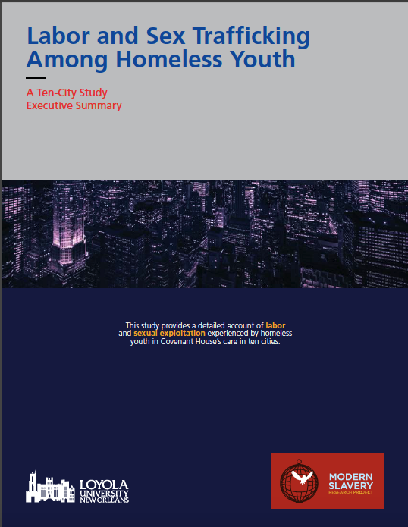

Slide 3
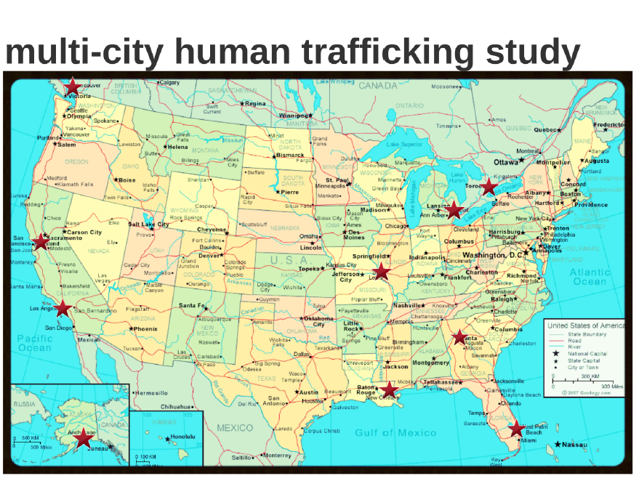

Slide 4
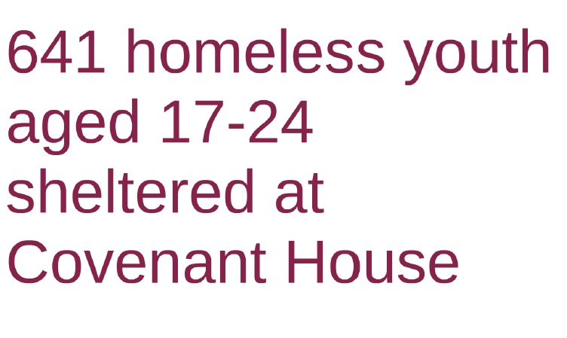

Slide 5
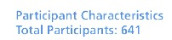

Slide 7
We asked the usual questions:
have you ever had an employer who
made you feel unsafe or in danger?
harmed you or threatened to harm you?
didn't pay you what you were promised?
paid you something other than money?
changed the nature of the work you were promised?
controlled your identification documents?
prevented you from talking to friends and family?
prevented you from quitting or leaving the job?

Slide 11
Force, fraud, & coercion

Slide 12
“His friend taught him that sometimes the girl needs to be disciplined and maybe the girl shouldn’t leave. That was not a good thing that he taught him. The first time, he wasn’t violent. [His mentor] taught him bad stuff—to be more violent, less caring.”

Slide 13
“You had to sleep in hotels. You had to eat outside food. You had to go through rules and just be in a room with one TV and not go outside and have your freedoms. It’s slavery. It’s slavery. I lost freedom, and I didn’t see it at first—but then they took my son.”

Slide 14

Commercial Sexual Exploitation of Children

Slide 15
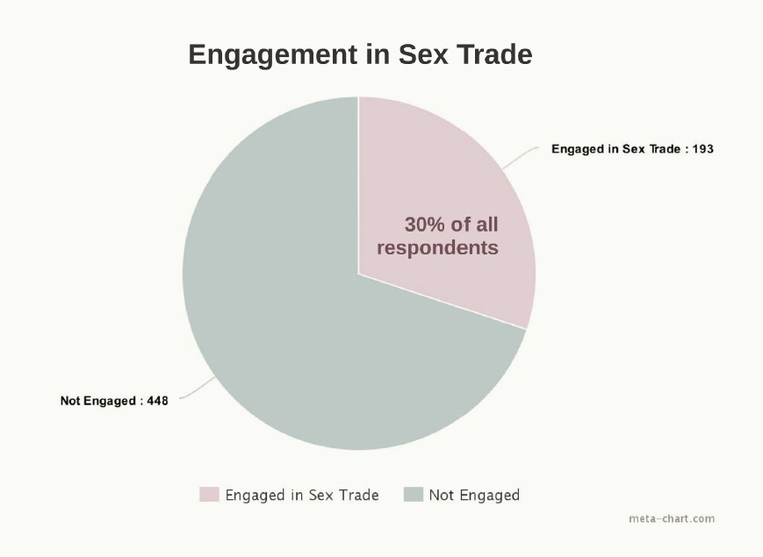

Slide 16
ECONOMIC FACTORS

Slide 17
“Like there was a time where the bottom of my sole was like there was no shoe. And my mom was like, you know how moms are, you can only get some new shoes at Christmastime or the beginning of the school year. I decided Christmastime. It snowed, I wore them out, so that’s my fault. He’s like, ‘Yeah, I’ll help you out. You do what I say, and I’ll get you three pairs of shoes.’ And I’m like, “Three?!”… So I had sex with him.”

Slide 18
“ Well, it was when I was in New York. I had sex for money, but it was just something so I could get my daughter some formula because she was a newborn, and I needed formula for her.…
I wasn’t doing it just to get my hair done and my nails done. It was just to make sure my child had something to eat.”

Slide 19
age of entry: 16-18 aging out coming out

Slide 20
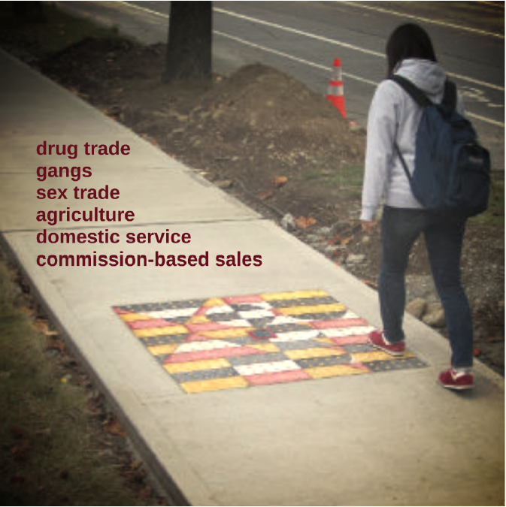
LABOR TRAFFICKING

Slide 21
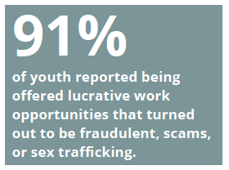

Slide 22

FAST MONEY, FALSE PROMISES
Recruiters target
online
on social media
on the street
at bus stations
outside homeless shelters
at government assistance offices

Slide 23
forced illicit activity
81%
of all labor trafficking victims had been forced to work in the drug trade

Slide 24
labor trafficking vs. labor exploitation
force, fraud, coercion

Slide 25
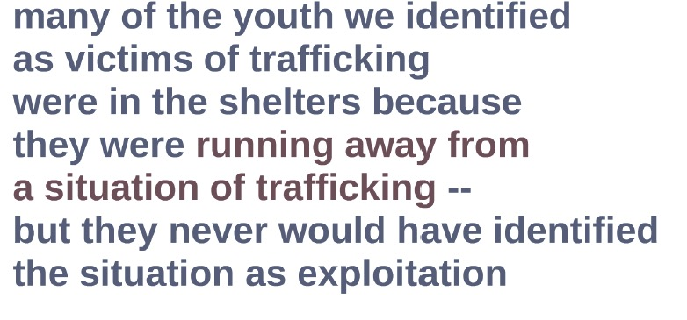

Slide 26
But…
Runaway and homeless youth rarely disclose trafficking situations
Why?
invincibility
pride
personal responsibility
lack (of knowledge) of rights

Slide 27
confidentiality and lack of negative consequences

Slide 28
Define “work”

Slide 29
what are trafficked youth seeking?
shelter
safety/protection
a new start
mentoring
a support system
a living wage
rights/dignity

Slide 30
so what can we do?

Slide 31
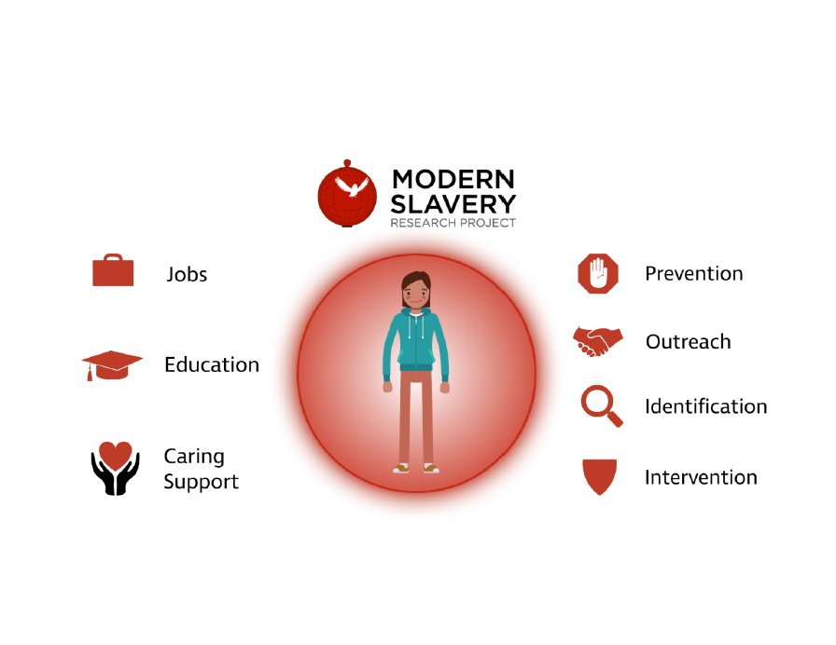
we asked participants for recommendations they would give to organizations and communities that wanted to improve their identification of and response to people who had similar experiences to those they described – essentially, we asked them HOW CAN WE MAKE ESCAPE POSSIBLE?

Slide 33

prevention
training is key:
  job search safety training
  job skills programs
  healthy sexuality/relationships
  financial management/housing

Slide 34

outreach
reach out to clients where exploiters do:
  social media
  job listing sites
  at bus stops/stations
  government assistance offices

Slide 35

inclusive identification
if you never ask, you’ll never know:
  low-stakes intake
  inclusive identification
  confidentiality
  where? orientation, counseling, job center

Slide 36

specialized intervention
protect them when they are with you
and when they are not:
  drop-in programs
  victim relocation networks
  safety planning and harm reduction
  trauma-informed counseling

Slide 38
questions? email Dr. Laura T. Murphy
modernslaveryresearchproject@gmail.com

