Slide 1
over-represented
under-served
&
Trafficking among young men, LGBTQ youth, foster youth,
and others who usually get lost in the trafficking shuffle
Laura T. Murphy
Helena Kennedy Centre for International Justice
Sheffield Hallam University, UK
modernslaveryresearchproject@gmail.com

Slide 2
some of this content may be disturbing or triggering

Slide 3
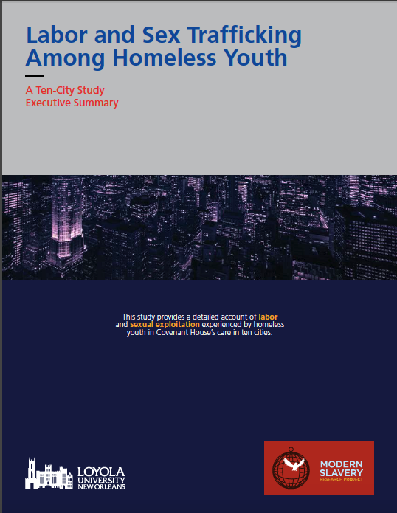

Slide 4


Slide 6
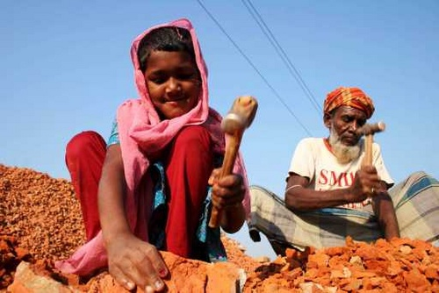
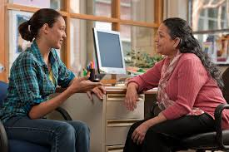

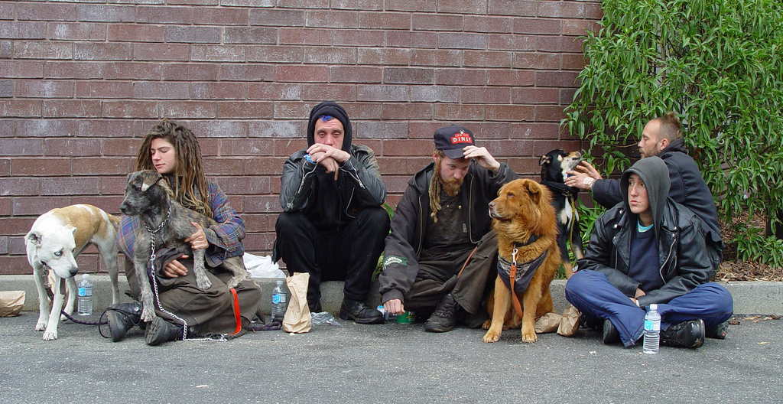
Can happen
to anyone:
any race,
gender,
age, or
nationality.

Slide 8
young men

Slide 10
sugar babies
have you ever had a “sugar mama” or “sugar daddy”?
has any older person ever offered you gifts or money in exchange for sex?
6%
of all youth interviewed had been in a “sugar baby” relationship

Slide 11
“When it’s a male doing that [sexual exploitation of minors], anybody can look at it like, ‘Oh yeah, he’s trying to rape her, this and that. He’s a pedophile, this and that.’ But if it was a female
doing it to a male, they’re not going to say that’s rape.… That’s not fair at all. That’s kinda crazy to me.”

Slide 12
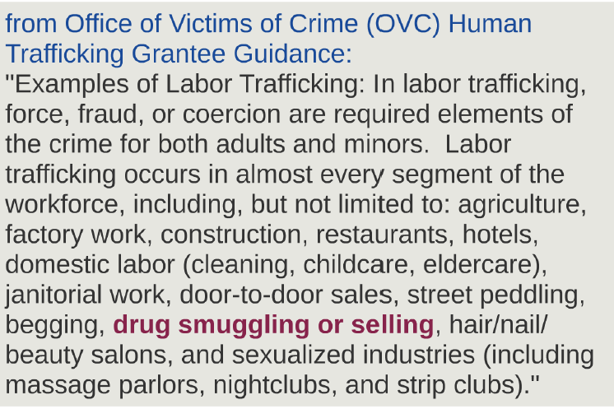
forced drug dealing
81%
of all labor trafficking victims had been forced to work in the drug trade

Slide 13
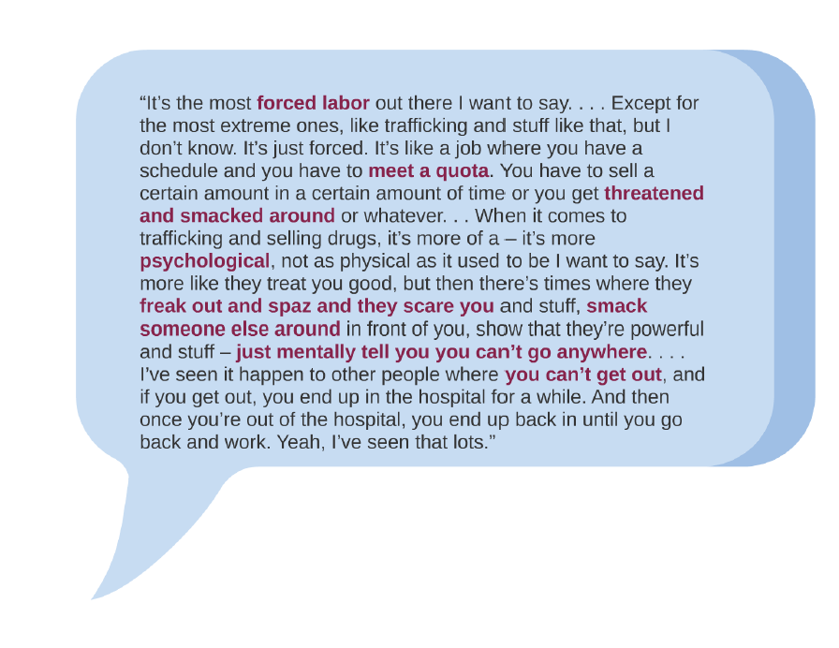

Slide 14
lgbt youth

Slide 16
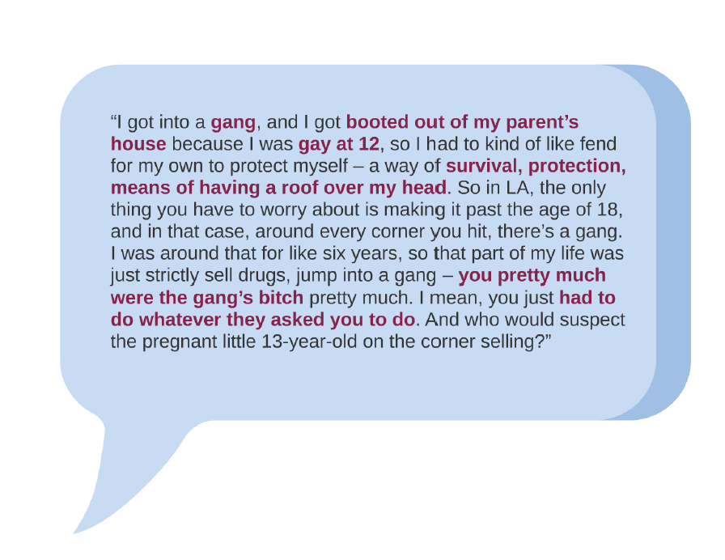

Slide 17
““So it’s like, hey, we’re at the end of our money. I’m going to keep you safe regardless. I mean, I’m going to have sex with this person just so
we can eat. And I’m a lesbian, so I mean it was a dude, so I mean I’m feeling uncomfortable. But still at the same time, I need to make my
ends meet, at the end of the day.”

Slide 18
foster youth

Slide 20
“I grew out of foster care when I turned 18, and then I just went homeless for a while, and then I moved from Denver to Vegas. That’s
when I got myself into it.”

Slide 21
“I was in the street because I went to foster care, and then I fled … then we met with another girl … and I went to the girl’s house, and then I did some sort of services for three days while I was staying there.”

Slide 22
age of entry: 16-18 aging out coming out

Slide 23
Health Disparities
Poverty
Education
Access to Health Care
Access to Mental Health
Chronic Illness
STI’s
Sexual Violence
Communicable Diseases
Physical Injuries
Employment/Unemployment
Food Deserts
Access to Transportation
Access to Education
Access to Stable Housing
Access to quality education
Read/Write/Comprehension
Digital Divide
Vision/Hearing
Intellectual Disabilities
Developmental Disabilities
Societal Norms
HUMAN TRAFFICKING
INTERSECTIONALITY
Social Justice
Mental Health
Race, Ethnicity, Culture, Language, Faith, Family, Gender, Sexual Identity
Personal/Property Crimes
Incarceration
Drugs/Alcohol
Prostitution
Loitering
Debtors Court
Socioeconomics
Diagnosed/Undiagnosed
Bipolar/PTSD
Addictions (Drugs/Alcohol)
Family History
Trauma Bonding
Suicide (attempted)
Environmental
Natural Disasters
Community segregation
Physical/Social barriers
Exposure to toxins/hazards
© Sunny Slaughter 2016

Slide 24
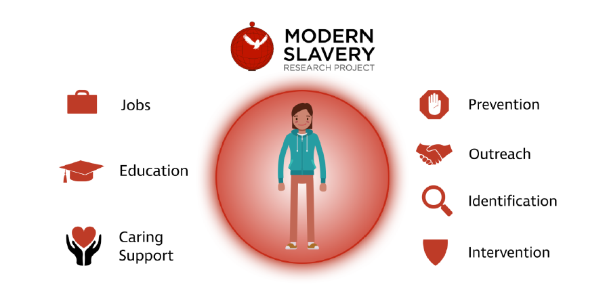

Slide 25

prevention
training is key:
  job search safety training
  job skills programs
  healthy sexuality/relationships
  financial management/housing

Slide 26

outreach
reach out to clients where exploiters do:
  social media
  job listing sites
  at bus stops/stations
  government assistance offices

Slide 27

inclusive identification
if you never ask, you’ll never know:
  low-stakes intake
  inclusive identification
  confidentiality
  where? orientation, counseling, job center

Slide 28

specialized intervention
protect them when they are with you
and when they are not:
  drop-in programs
  victim relocation networks
  safety planning and harm reduction
  trauma-informed counseling

Slide 29
Questions? Contact Dr. Laura T. Murphy
modernslaveryresearchproject@gmail.com

